Slide 1



TOOLKIT
CASCADE TRAINING
Project Sustainability
SOUPHANOUVONG UNIVERSITY
1st December 2021
By: Palitha DOUAGCHACK
E-mail: palitha_su@yahoo.com
SOUPHANOUVONG UNIVERSITY

Slide 2
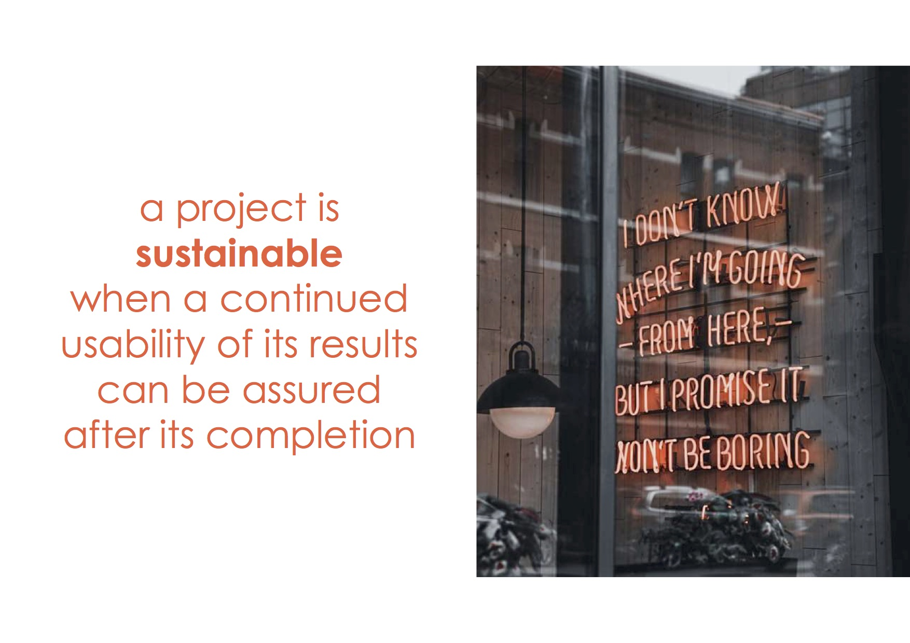

Call for proposal
Call for individual scholarship and fellowship
Call for tenders
Technical cooperation schemes
SOUPHANOUVONG UNIVERSITY
SOUPHANOUVONG UNIVERSITY
Notes:
Call for proposal:
Proposals describe planned activities, information on who will carry them out and how much they will cost.
Proposal must be relevant to policy background and general objectives defined by the call, but the applicant can be free to propose and develop its own idea

Slide 3
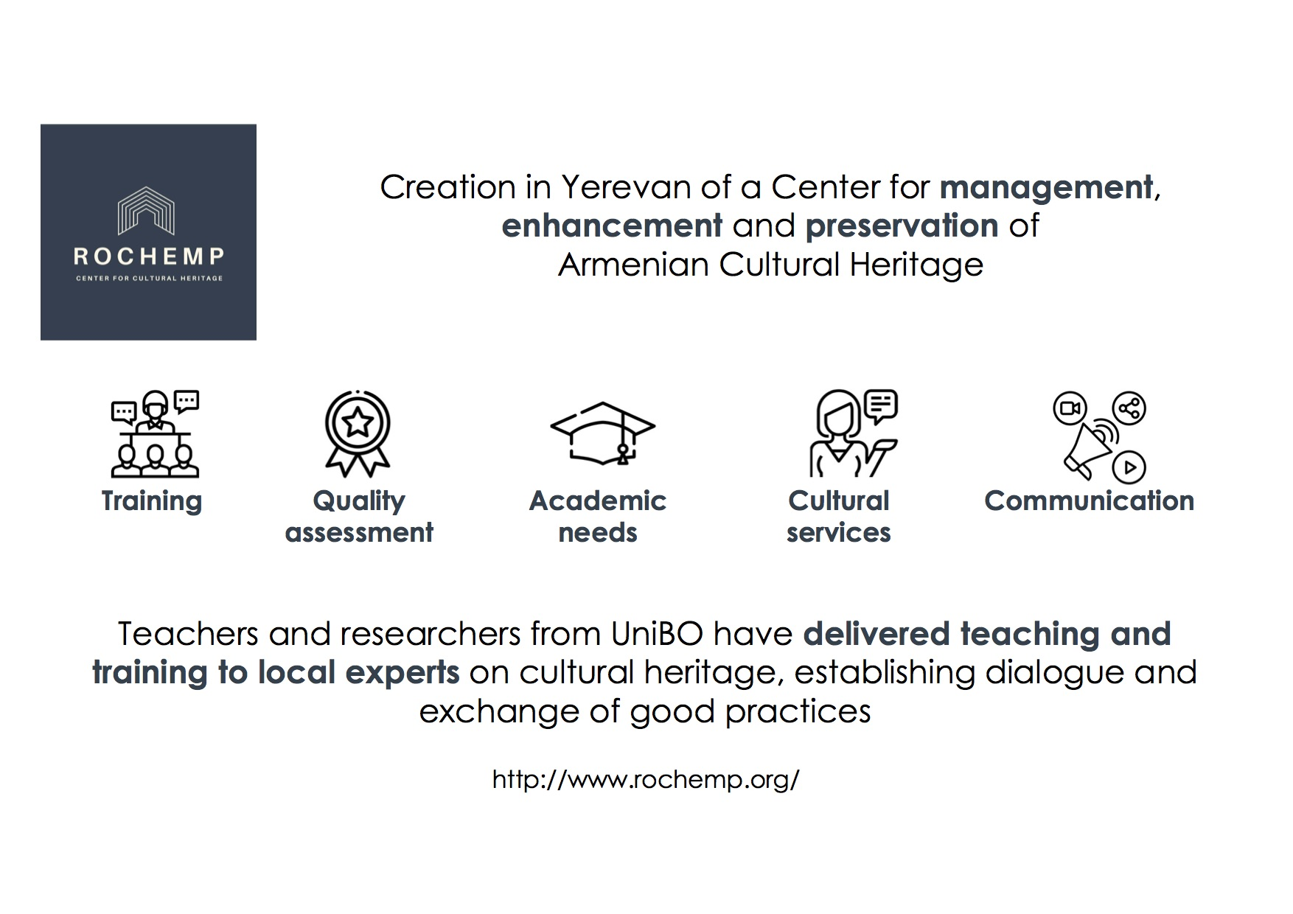
SOUPHANOUVONG UNIVERSITY

Slide 4
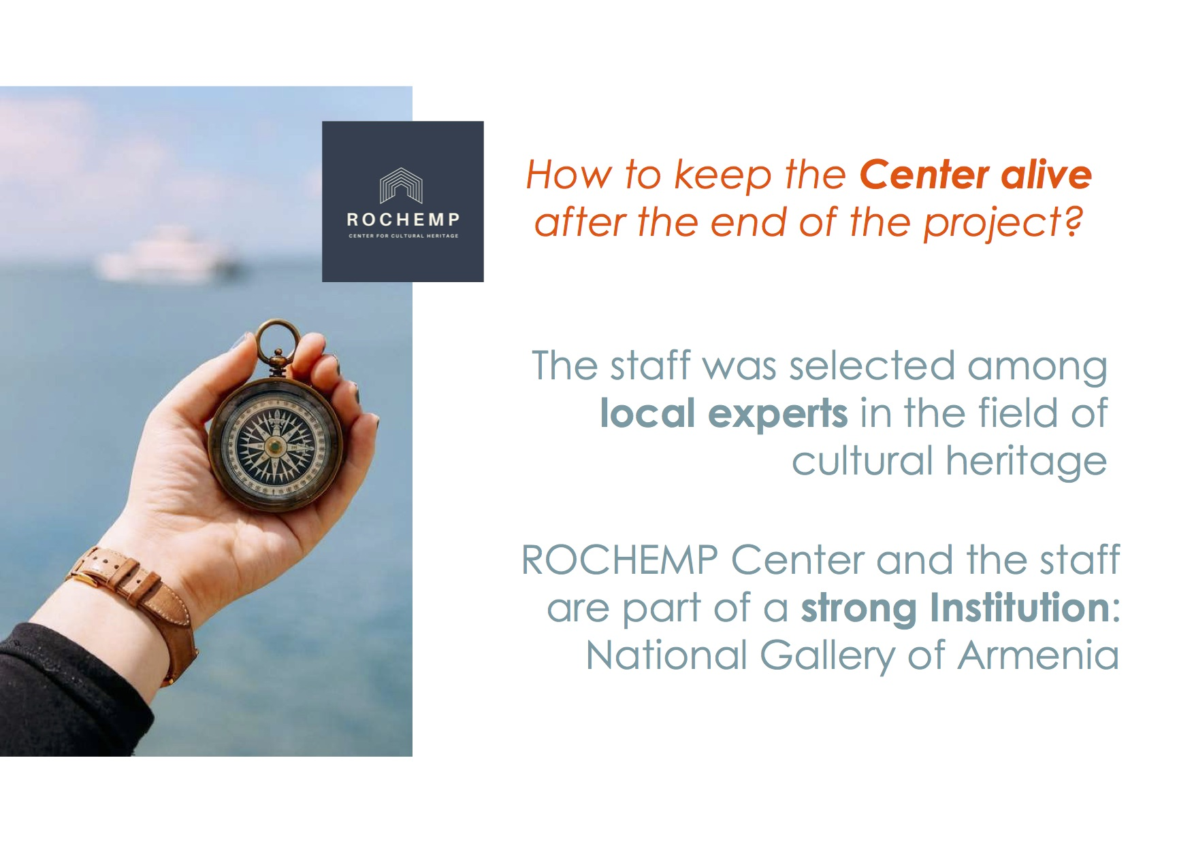
Documents concerning a call for proposals:
Work Programme/Guide for Applicants
Application forms and annexes: concept note/full project description, budget, logical framework matrix (may bee filled through online platforms)
Model grant agreement
Other documents
SOUPHANOUVONG UNIVERSITY
SOUPHANOUVONG UNIVERSITY

Slide 5

Guide for applicants
Guide for applicants/guidelines/call instructions
Background/policy context
Objectives of the programme
Topics/challenges/priority issues under the call for proposal and expected results
Overall financial allocation for the call and size of the grants (% of co- financing)
Eligibility of applicants
Partnership and eligibility of partners
Eligible actions and eligible costs
Instruction for completing the application form and administrative annexes
Instructions for submission of proposals and procedures to follow
Instructions to fill the budget tables
Deadline and information sources
Check list
Evaluation criteria and selection of applications
SOUPHANOUVONG UNIVERSITY
SOUPHANOUVONG UNIVERSITY

Slide 6
Tips for Sustainability
Feet on the ground: relate the project to the pre-existing context, to avoid unsustainable actions
Do not ear: LISTEN!: projects are made by people.
Their socio-cultural background matters
Make it count: a project is sustainable if all partners know how and why it matters
Mind the gaps: they can set the basis for a project to be!
SOUPHANOUVONG UNIVERSITY

Slide 7
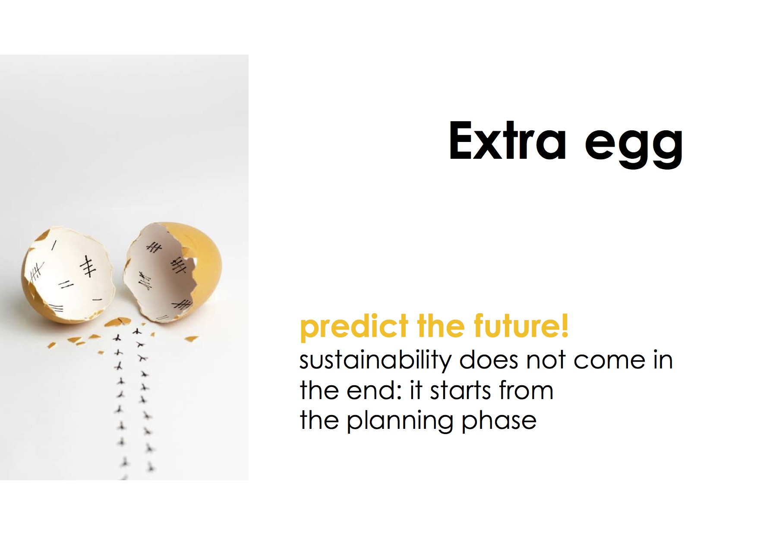
SOUPHANOUVONG UNIVERSITY

Slide 8
Souphanouvong University
Thank You for Your Attention
Any Questions?
SOUPHANOUVONG UNIVERSITY

